Slide 1
Adaptive Whitening in Neural Populations with Gain-modulating Interneurons
Lyndon R. Duong, David Lipshutz, David J. Heeger, Dmitri B. Chklovskii, Eero P. Simoncelli

Slide 2
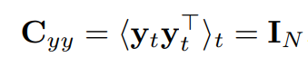
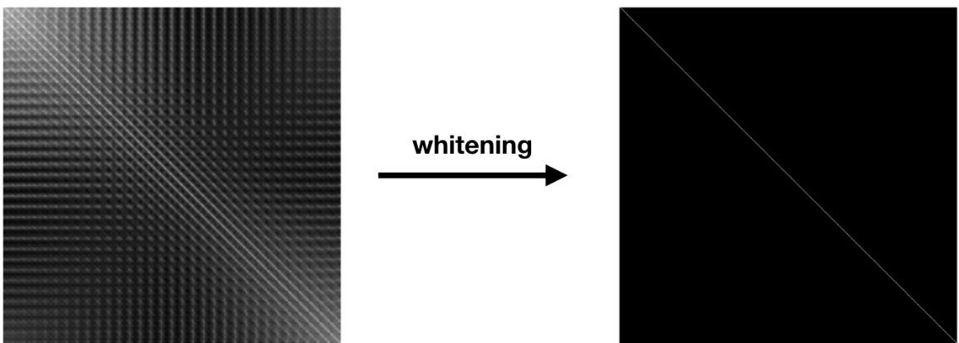
Statistical whitening

Slide 3
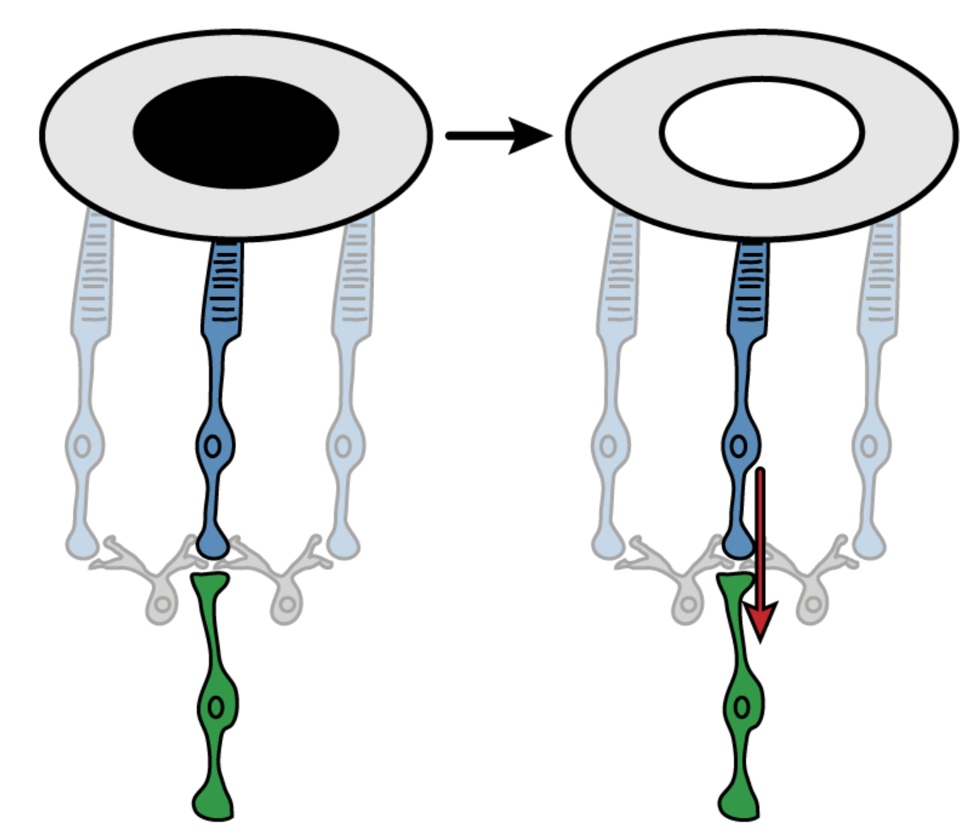
The early visual system does statistical whitening

Slide 4
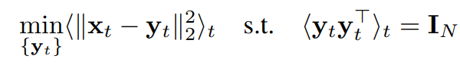
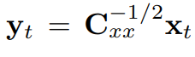
Zero-phase component analysis (ZCA)
Assuming y = WX, there are multiple ways to solve W so that
Zero-phase component analysis can satisfy this constraint with a unique solution. Minimize the following objective:
The solution to this problem is
However, for ZCA to be biologically realistic, we need a way to do ZCA online with a constantly changing C_{xx}

Slide 5
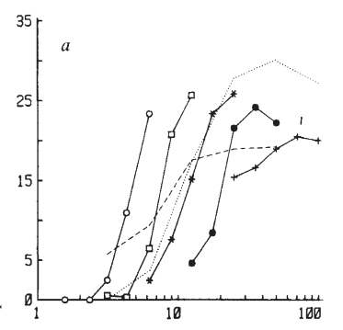
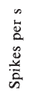
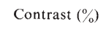
Gain control performs adaptive whitening
Taken from Ohzawa, Sclar & Freeman (1982)

Slide 6
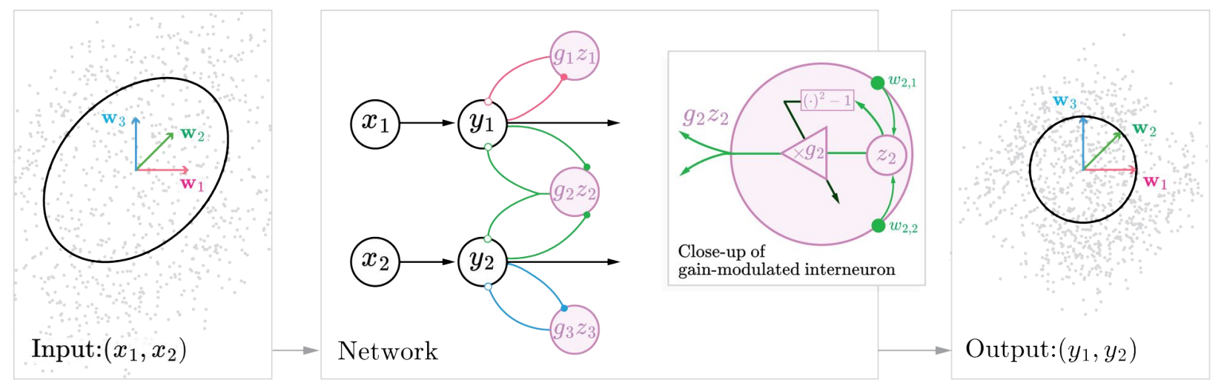
RNN with gain-control interneurons

Slide 7
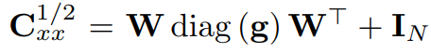
Decomposition of C_{xx}
Where:
W = Fixed overcomplete matrix of synaptic weights
g = vector of gains that adaptively adjust to whitening matrix

Slide 8
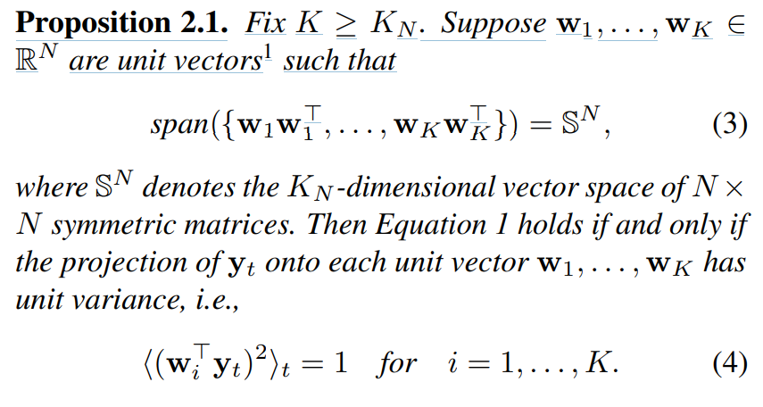
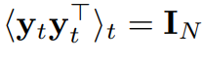
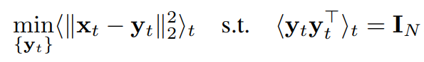
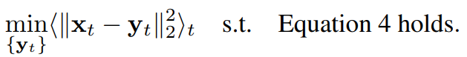
Online ZCA optimization function Step 1: Replace the covariance constraint
N = dimension of x
= dimension of y
K = number of interneurons

Slide 9
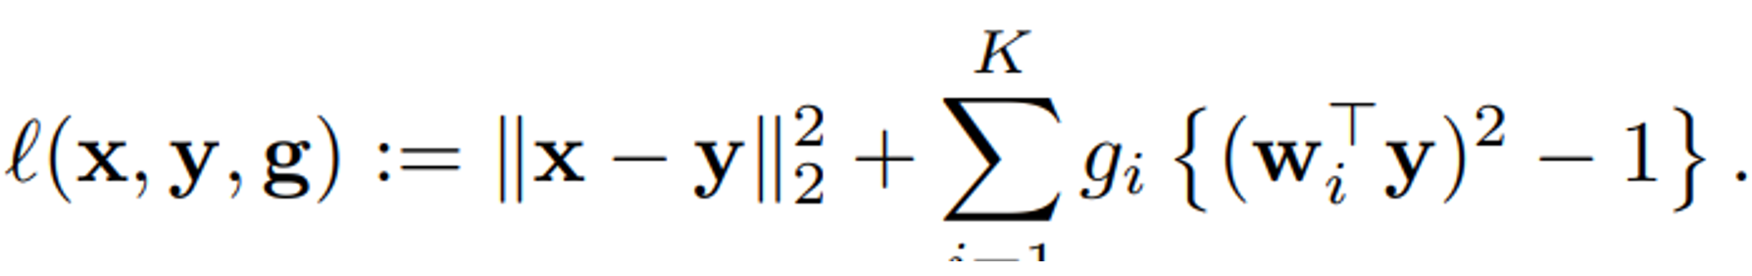
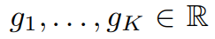
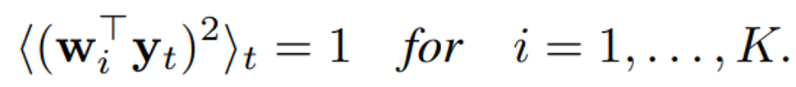
Step 2: Define an optimization function with Lagrange multipliers
are Lagrange multipliers that enforce the constraint

Slide 10
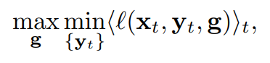
This is an online RNN: What about the time dynamics of y?
‘Fast’ neuron dynamics vs ‘Slow’ gain updates
Assumption: y reaches equilibrium before the gain vector g is adjusted.
Step 1: Find the equilibrium of y for set g
Step 2: Perform gradient descent upon g to optimize previous function

Slide 11
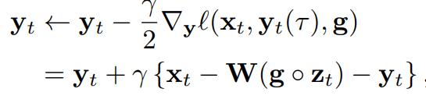
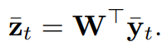
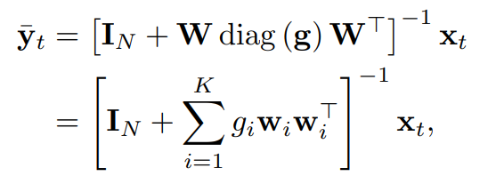
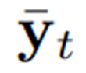
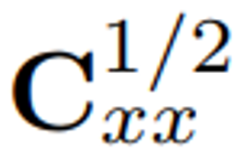
Equilibrium of fast neural dynamics
Notes:
The inputs to the inhibitory interneurons are:
Equilibrium is reached when:
converges to

Slide 12
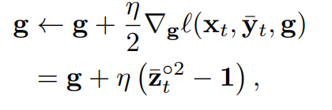
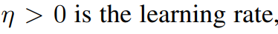
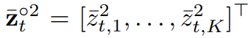
Slow gain dynamics

Slide 13
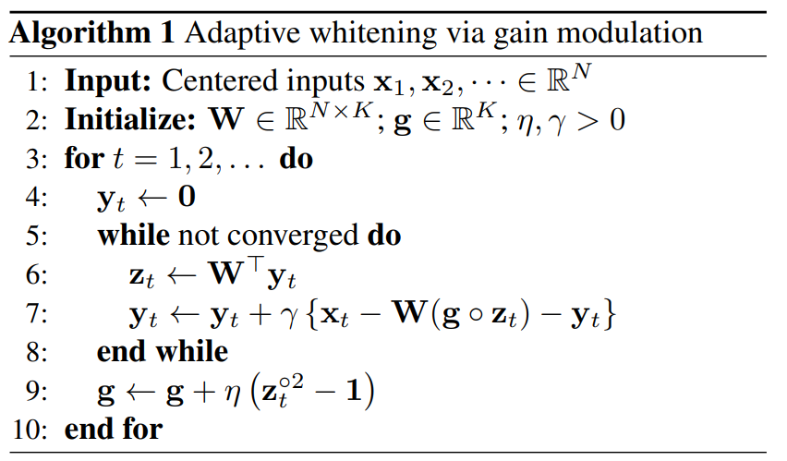
Algorithm in a nutshell

Slide 14
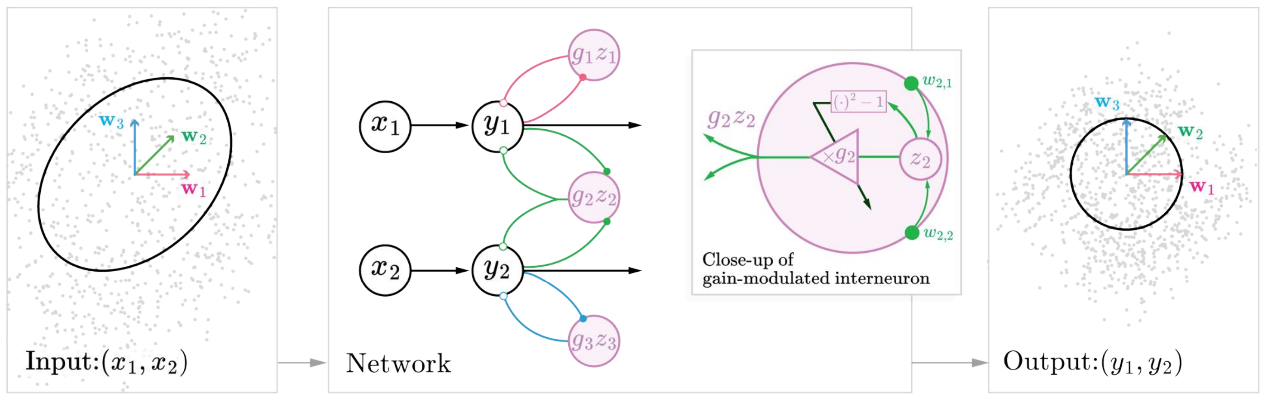
Recap of the model

Slide 15
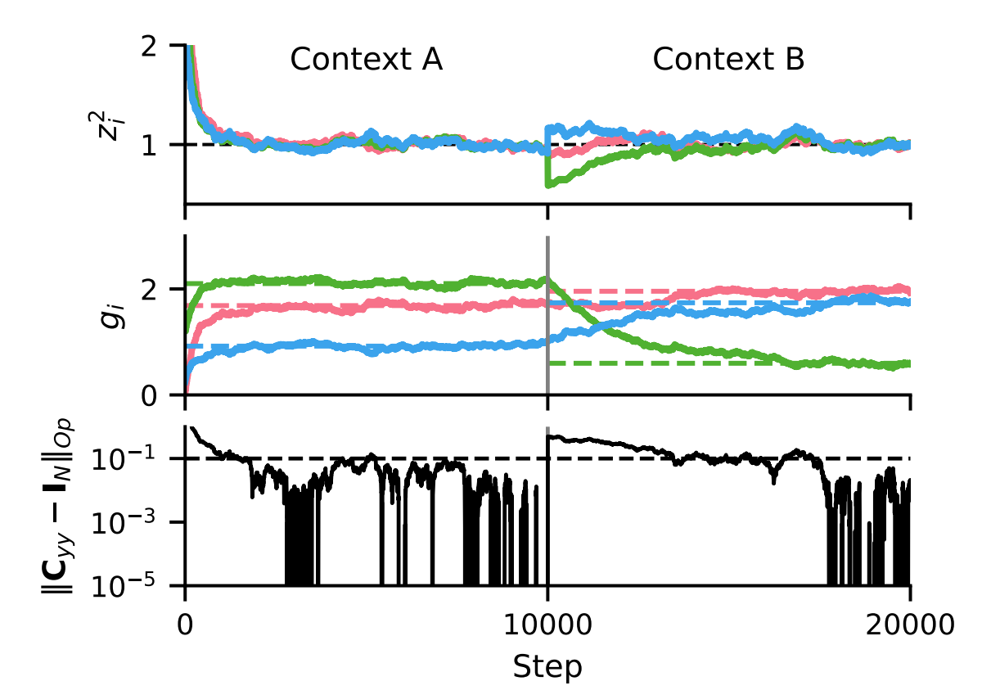
Z converges to 1 and error goes to 0

Slide 16
Convergence rate depends on W
Experienced with 3 “types” of W_{NxK}:
Random: i.i.d. Gaussian entries
Optimized: Random, but columns are optimized to have minimum mutual coherence (absolute cross-correlation between columns) and cover the ambient space
Spectral: First N columns are eigenvectors of the data and rest are zeros.

Slide 17
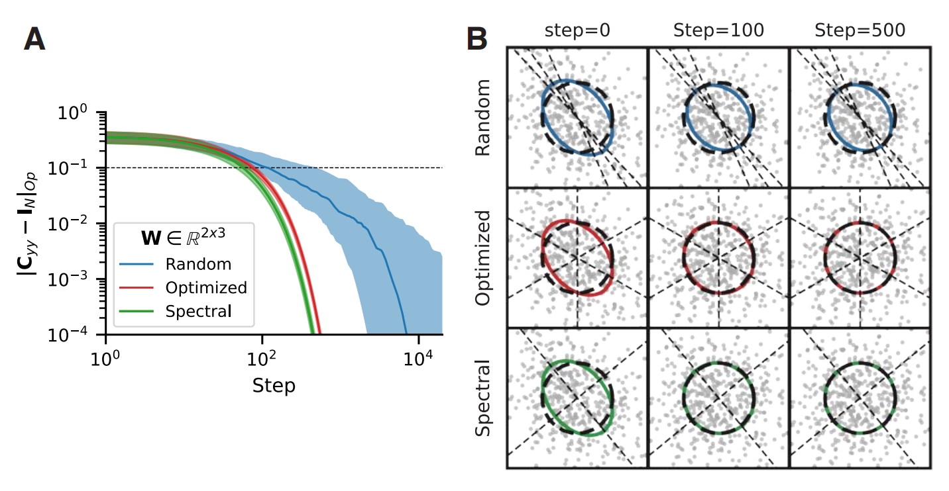
Convergence rate depends on W

Slide 18
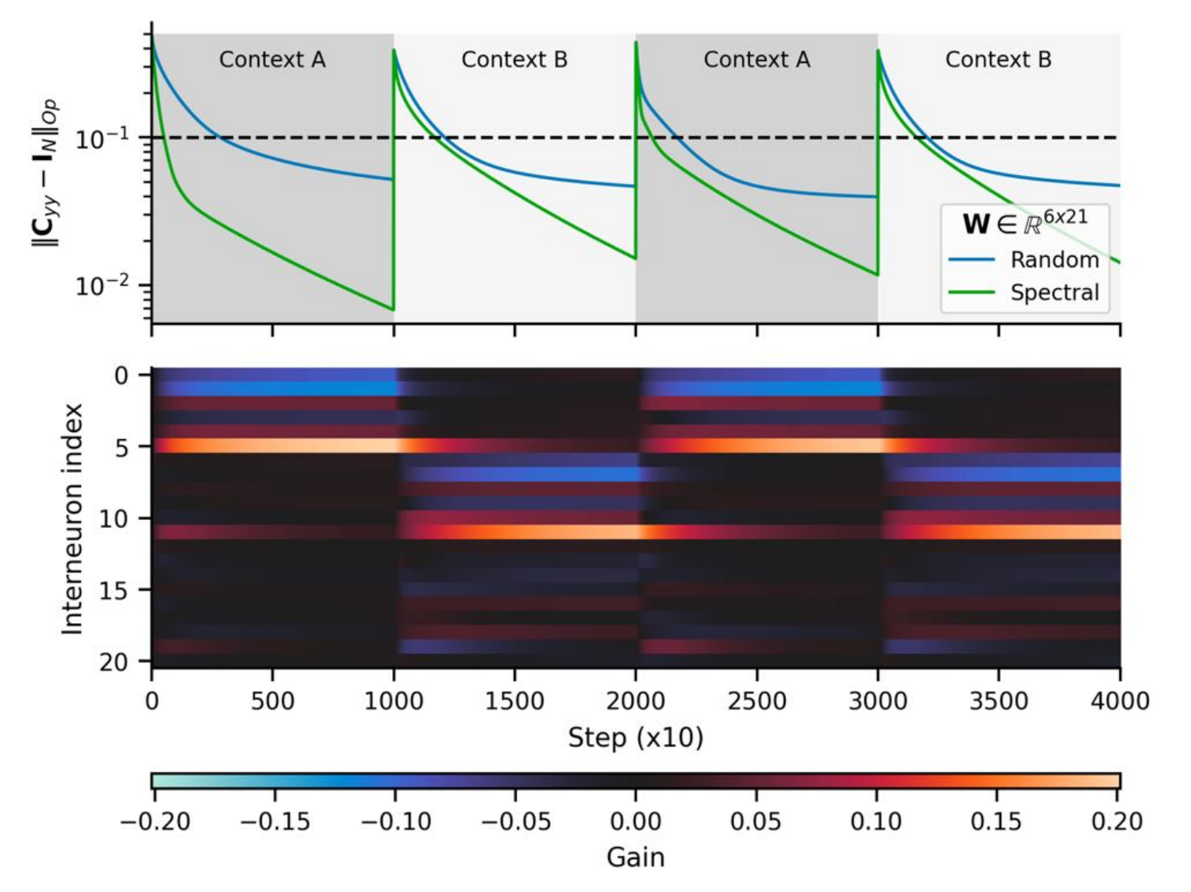

Slide 19
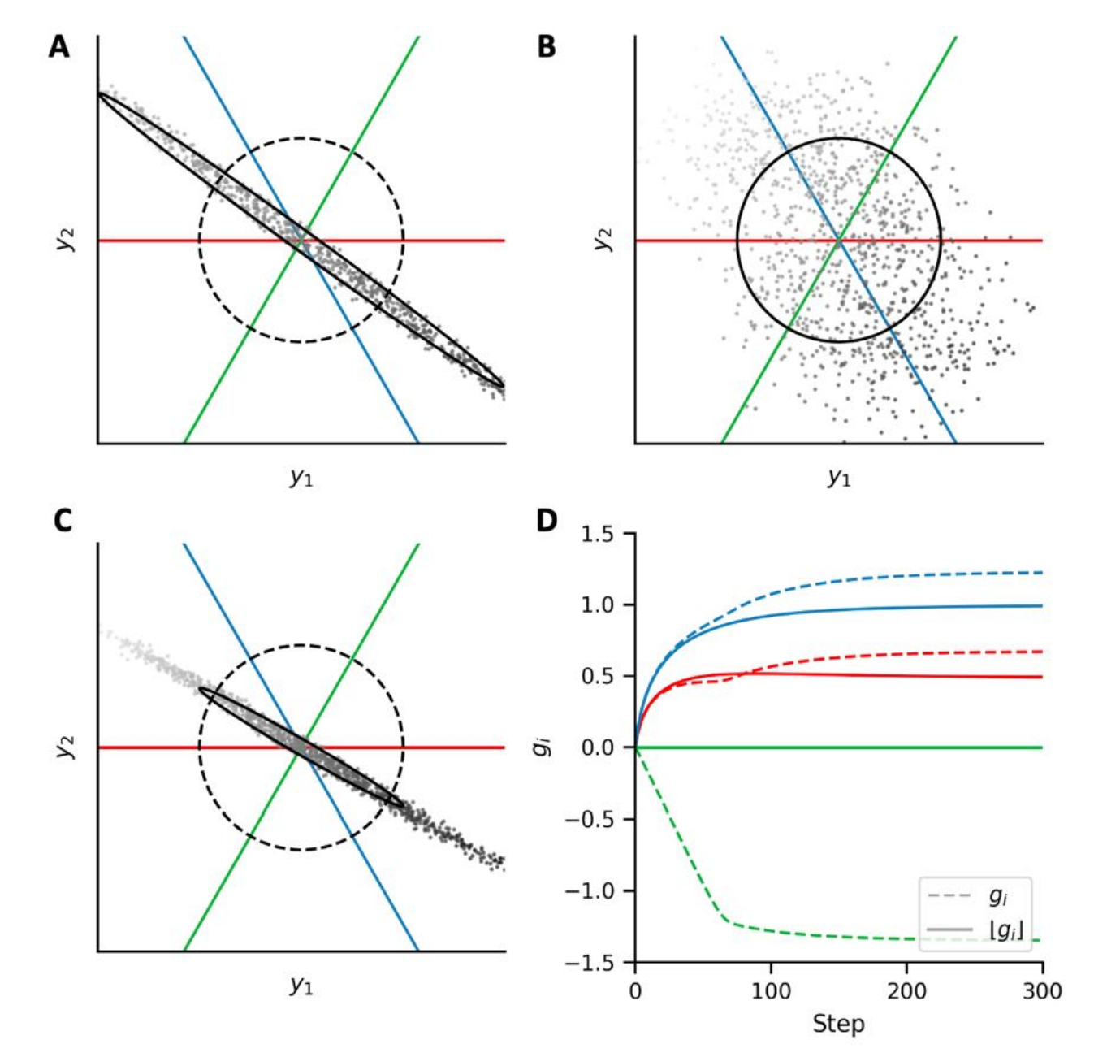

Slide 20
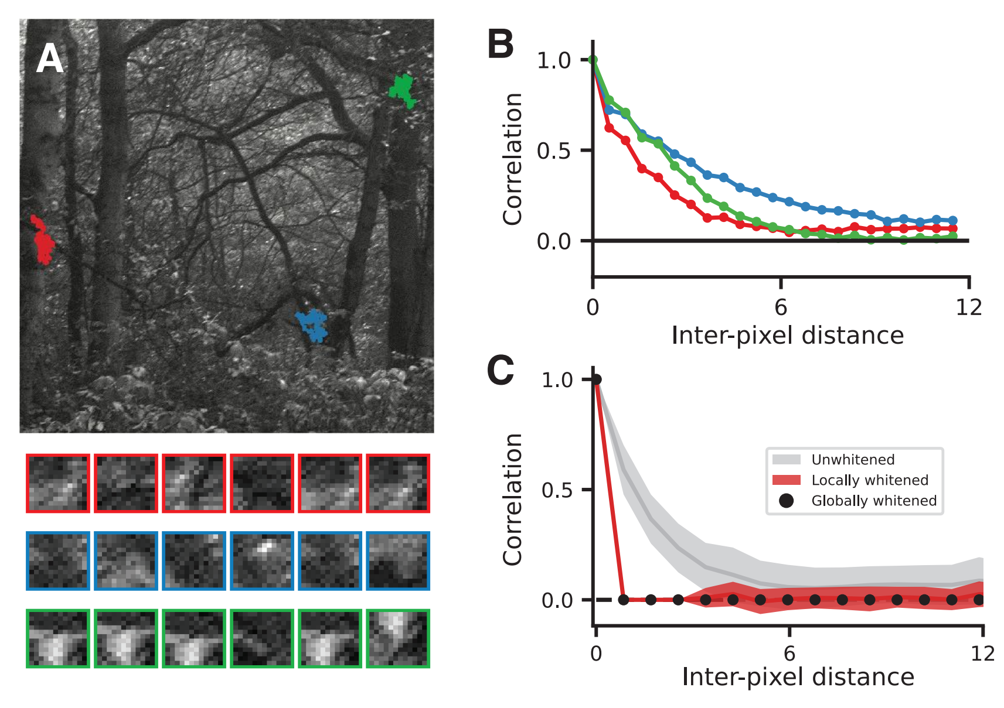

Slide 21
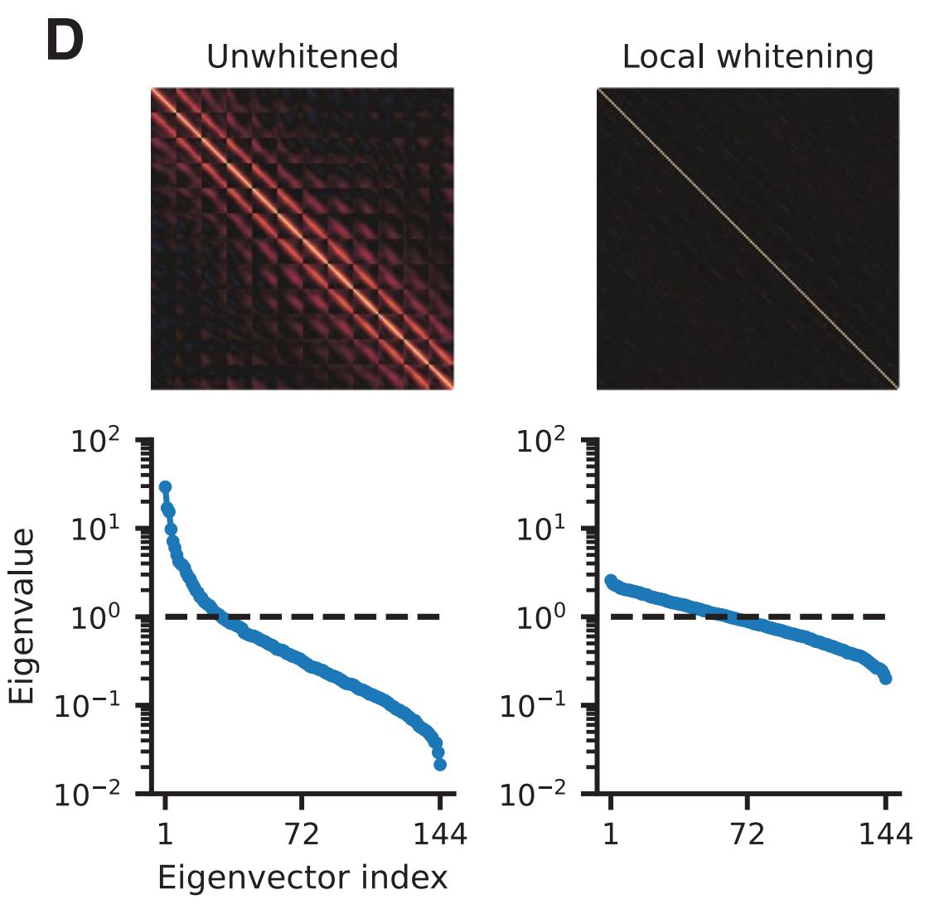

Slide 22
Biological limitations
There are more interneurons than input neurons in their model, which is biologically unrealistic.
Matrix W is random: There’s probably a smarter way to do this.
Assumption of “instant” neural dynamics
Strengths:
Intuitive way to unify inhibition, gain control and statistical whitening under one framework
Gain control happens without actually changing the input-output curve of the neuron, which is biologically realistic

